Slide 1



TDD in TypeScript
Test Driven Development
LEANDOG.COM
DEV3LSOLUTIONS.COM
Notes:
8 hours – 1 hour lunch break
7 hours = 420 minutes
10-minute break every hour
- Try to break on exercise to catch up anyone

Slide 2
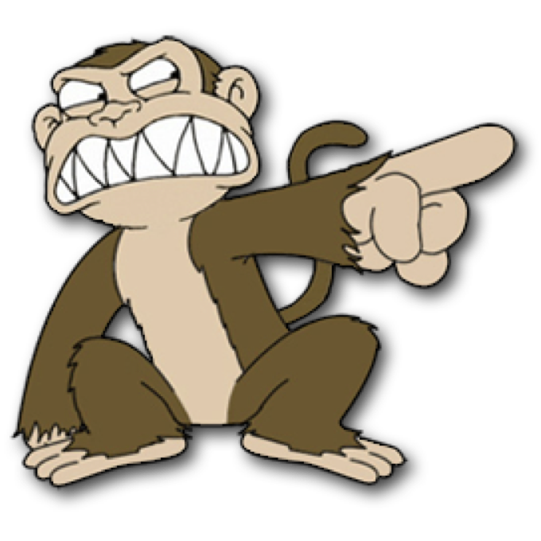

Justin Beall
Justin Beall
15 Years Software Engineering
CSM, A-CSD, CSPO, SA
Favorite language, Python
15 Years Software Engineering
CSM, A-CSD, CSPO, SA
Favorite language, Python
2
Notes:
2m : 2m

Slide 3
INTRODUCTIONS
INTRODUCTIONS
3
Notes:
18m : 20m
Who are we?
Learning environment, feel free to ask questions.
What is everyone’s familiarity with the stack / software development.
Breakout rooms
Regular breaks – shoot for 10 till the hour, leaves room for questions and catch up as necessary
Who are you?
What do you do?
What do you want to learn in class?
Tell me about your automation experience

Slide 4
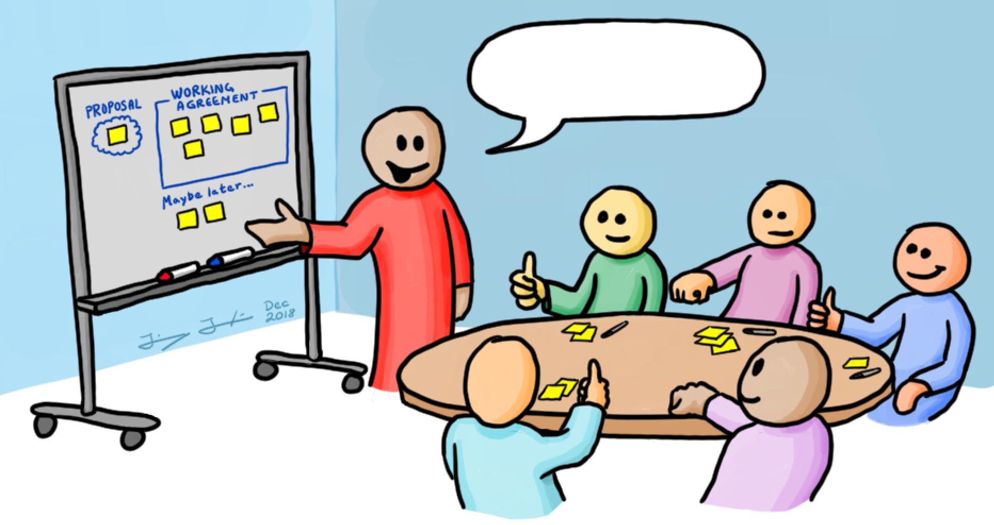

Course Objectives
Working Agreements
Understanding the Benefits of TDD
Learning Good Testing Practices
What code smells to look for
Level up your knowledge!
Start / End Time
- Respect your peers; don’t be late
Be Present
- Participate
Own your learning
- Speak up if you don’t understand something
You aren’t done until the (virtual) person next to you is done
Code (1) Make it work; (2) Make it better
Notes:
5m : 25m

Slide 5
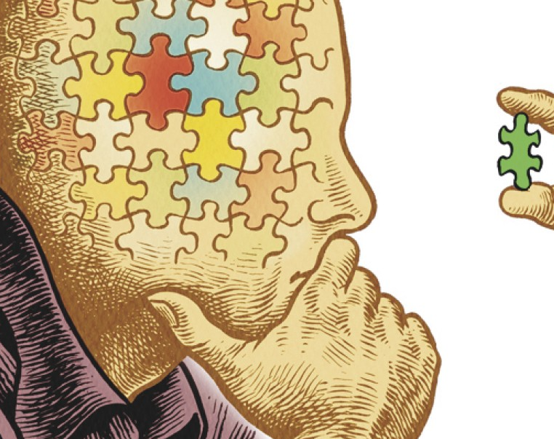
Why Are We Here?
Notes:
10m : 35m
How are releases performed currently?
Value Stream Map - where would the wait be?
What is testing at a higher level?
-- war stories

Slide 6

Course Objectives
Recognize Available ATDD Tools
Identify Gherkin Syntax
Practice with Automation Exercises
Integrate ATDD Into Daily Work

Slide 7
Let’s start at the beginning...
Test-driven development (TDD) is a software development process that relies on the repetition of a very short development cycle:
Requirements are turned into very specific test cases, then the software is improved to pass the new tests, only. This is at the Unit Level (Classes and Methods in Code).
This is opposed to software development that allows software to be added that is not proven to meet requirements.

Slide 8
What is Test Driven Development?
Simple, high-feedback incremental coding technique
Write tests as specs, prior to code
Immediate feedback from Test Runner
Core of the cycle:
Write a test
Write the code to make the test pass
Refactor

Slide 9
TDD is NOT new
“A software system can best be designed if the testing is interlaced with the designing instead of being used after the design.” - Professor Alan J. Perlis
NATO SOFTWARE ENGINEERING CONFERENCE 1968
Notes:
An American computer scientist and professor at Purdue University, Carnegie Mellon University and Yale University. He is best known for his pioneering work in programming languages and was the first recipient of the Turing Award.

Slide 10
History
Automated unit testing nothing new
But writing the tests incrementally and first is
Automation originally devised by Ward Cunningham
Honed by Kent Beck in Smalltalk
Incorporated as a practice of Extreme Programming (XP)
Buzzword History:
Test-first programming
Test-first design
Test-driven development

Slide 11
Kent Beck’s "rediscovering" TDD
“The original description of TDD was in an ancient book about programming. It said you take the input tape, manually type in the output tape you expect, then program until the actual output tape matches the expected output. After I'd written the first xUnit framework in Smalltalk I remembered reading this and tried it out. That was the origin of TDD for me. When describing TDD to older programmers, I often hear, "Of course. How else could you program?" Therefore I refer to my role as "rediscovering" TDD.”
Notes:
American software engineer Kent Beck, who is credited with having developed or "rediscovered" the technique, stated in 2003 that TDD encourages simple designs and inspires confidence.
“A software system can best be designed if the testing is interlaced with the designing instead of being used after the design.” - Professor Alan J. Perlis (NATO SOFTWARE ENGINEERING CONFERENCE 1968)

Slide 12
TDD and Testing Outcomes
Creates testable code by definition
Obvious but significant!
Writing tests after code built usually much harder
Therefore fewer tests get written
Contributes to minimizing defects

Slide 13
More Importantly...
TDD promotes better design
Teaches you how to design isolated pieces
Creates comprehensive developer-level documentation
Development pacing
Constant positive feedback
Pavlovian effect
Tests are specifications!
Should never build a system without specs

Slide 14
Doing TDD
A skill which you must learn and practice
It should be initially awkward
Expect some level of addiction
Fast feedback & Green Tests = more dopamine!

Slide 15
TDD Costs (Perceived)
Takes twice as long
Reality: easily saves more time
Maintain test and code
Reality: beats maintaining written detailed docs
Not all that valuable - tough work is in the “wiring”
Reality: not if classes are designed correctly in the first place

Slide 16
TDD Costs (Real)
Initial learning curve
Continual Learning: How do I test X?
Can promote overconfidence
Maintaining tests can be considerable work

Slide 17
TDD Rewards
Higher confidence levels
Continual feedback; Pavlovian response
Eases introduction of new functionality
Allows for refactoring with impunity
Continual progress: add value...
Add value every programming session, every few minutes
Avoid going too astray

Slide 18
The Implied Rules of TDD
Test everything that could possibly break.
Do not write any production code until you have written the code that will test it.
Code is not checked in until 100% of unit tests run.

Slide 19
The three laws of robotics The Three Laws of TDD
You may not write production code unless you’ve first written a failing unit test.
You may not write more of a unit test than is sufficient to fail.
You may not write more production code than is sufficient to make the failing unit test pass.
Notes:
“Following these laws perfectly doesn’t always make sense.
Sometimes you’ll write a larger test.
Sometimes you’ll write extra production code.
Sometimes you’ll write tests after you’ve written the code to make them pass.
Sometimes it’ll take more than two minutes to go around the loop.
The goal isn’t perfect adherence to the laws—it’s to decrease the interval between writing tests and production code to a matter of minutes. “ - Uncle Bob

Slide 20
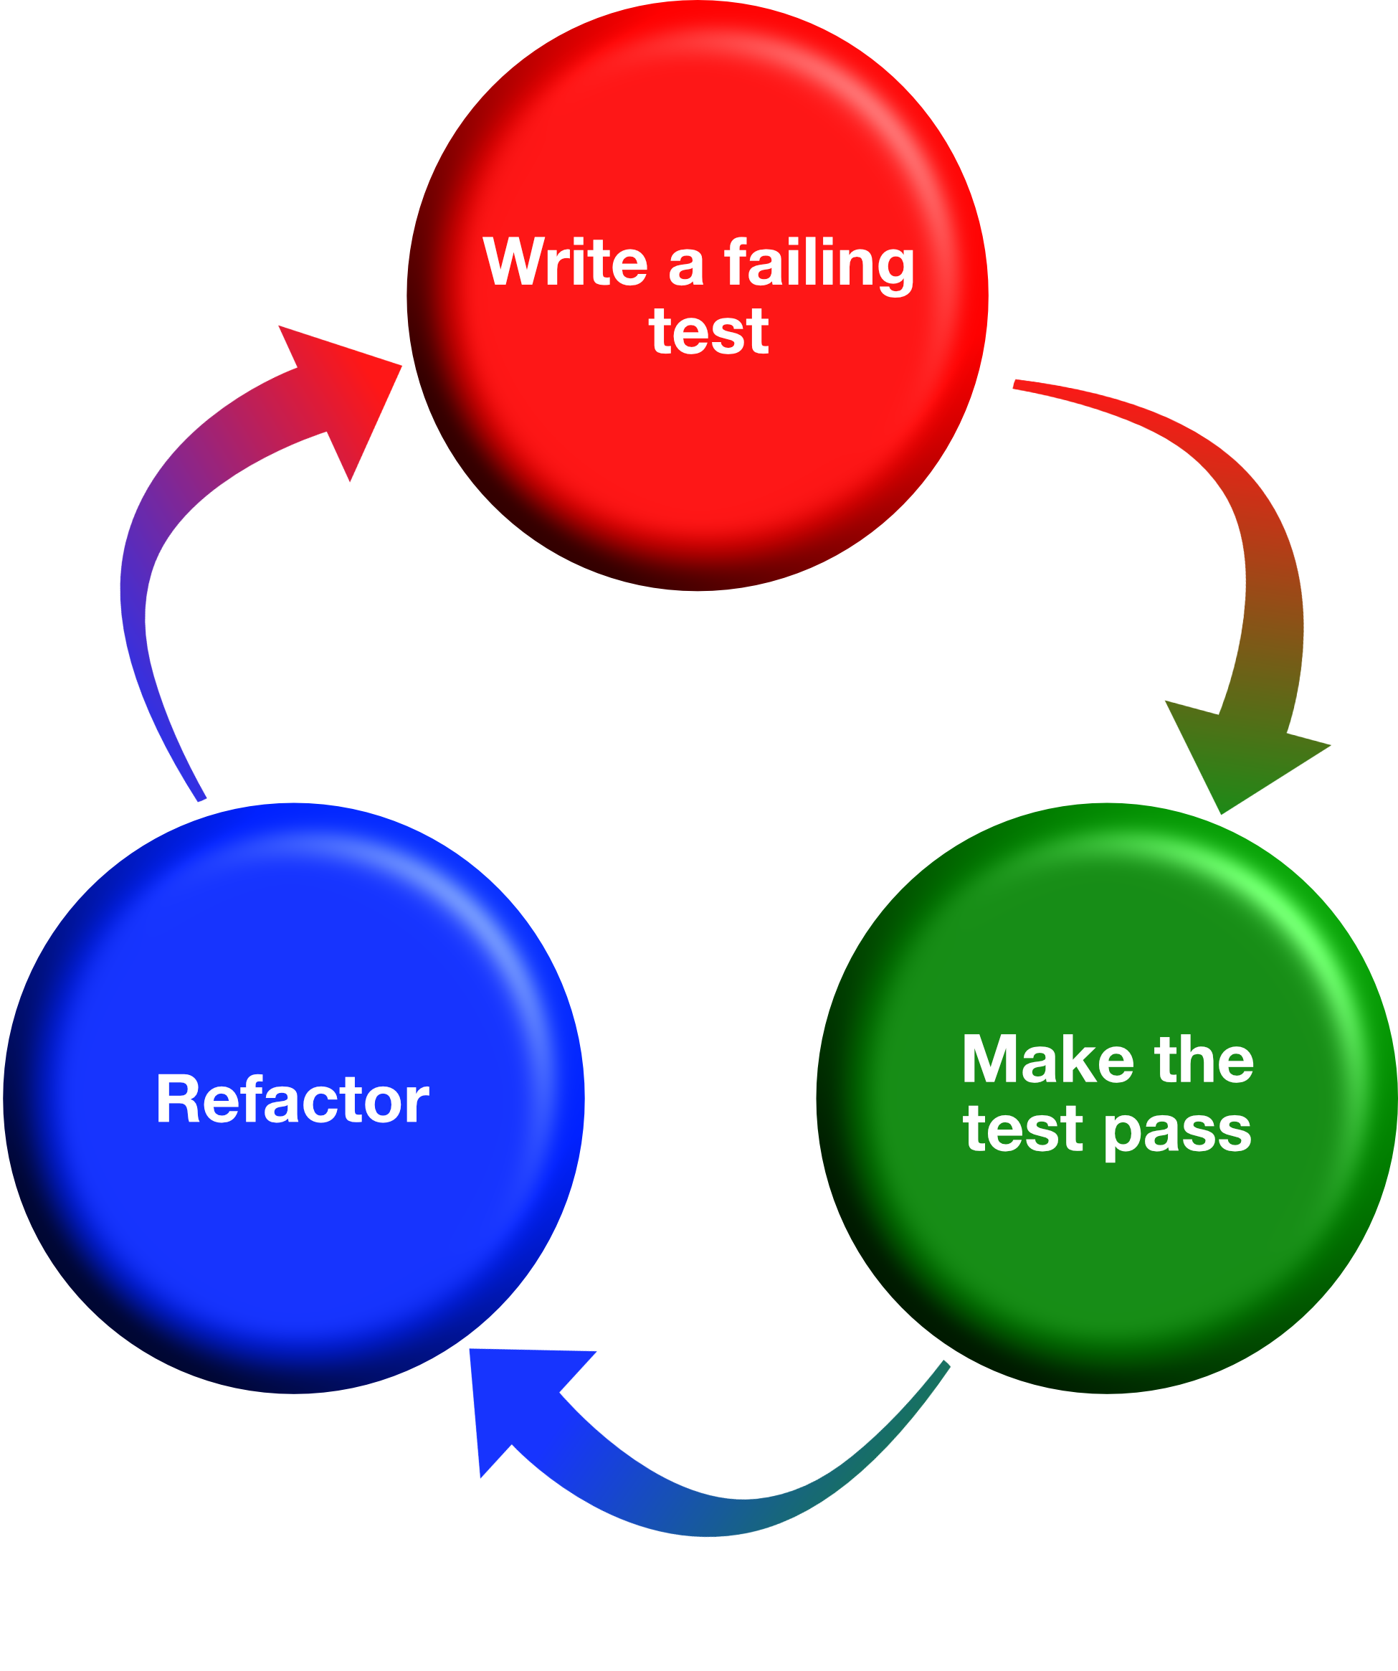
Red, Green, Refactor

Slide 21
Basic TDD Steps
Create test class
Create test method (write test)
Create production class and method (simplest implementation to pass compilation)
Run Test Runner (it will fail)
Write the simplest code to make the test run
Run Test Runner (it will work this time)
Refactor the code
Run the test again to make sure refactoring didn’t break the code

Slide 22
Basic Tool of TDD: xUnit
Simple testing framework
Originally built by Kent Beck and Eric Gamma
Pervasive implementation
Java, .NET, Smalltalk, Ruby, C/C++, Perl, Python, etc
Test Runner already in many IDEs
Rubymine, Rider, Visual Studio, Eclipse, IntelliJ, PyCharm, etc.
Notes:
xUnit is the collective name for several unit testing frameworks that derive their structure and functionality from Smalltalk's SUnit. SUnit, designed by Kent Beck in 1998
We are using MiniTest for this course

Slide 23
Unit Test Tooling for This Class
Test::Unit
Original xUnit based testing framework
MiniTest
Successor to Test::Unit
RSpec
A BDD (behavior driven development) framework
Notes:
xUnit is the collective name for several unit testing frameworks that derive their structure and functionality from Smalltalk's SUnit. SUnit, designed by Kent Beck in 1998
We are using MiniTest for this course

Slide 24
Unit Test Tooling for This Class
NUnit -
Specflow -
Notes:
xUnit is the collective name for several unit testing frameworks that derive their structure and functionality from Smalltalk's SUnit. SUnit, designed by Kent Beck in 1998
We are using MiniTest for this course

Slide 25
DEMO - Key Code Concepts
Incremental steps drive out the interface
Hardcoding forces more test coverage
Small, small steps
Run Tests to get negative feedback first
Always refactor to eliminate duplication
Run Tests after each small refactoring

Slide 26
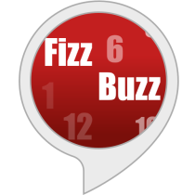
Here comes the boss...
Notes:
This is the part where we jump into a browser and go to CyberDojo.org
https://cyber-dojo.org/kata/edit/0z80Rs

Slide 27
Quick, look busy!
Write a program that prints the numbers from 1 to 100.
But for multiples of three print “Fizz” instead of the number and for the multiples of five print “Buzz”.
For numbers which are multiples of both three and five print “FizzBuzz”.

Slide 28
Let’s create the project
$ mkdir fizzbuzz
$ cd fizzbuzz
Create a file called ‘Gemfile’:
# Gemfile source "https://rubygems.org" gem "minitest"

Slide 29
Let’s setup the project
Delete Hiker.cs
Delete HikerTest.cs
Create FizzBuzz.cs
Create FizzBuzzTest.cs

Slide 30
$ bundle install
Fetching gem metadata from https://rubygems.org/............. Resolving dependencies... Using bundler 1.17.2 Using minitest 5.11.3 Bundle complete! 1 Gemfile dependency, 2 gems now installed. Use `bundle info [gemname]` to see where a bundled gem is installed.

Slide 31
Create our first test file ‘fizzbuzz_test.rb’:
require 'minitest/autorun' class FizzBuzzTest < Minitest::Test def test_returns_fizz_when_passed_3 assert_equal "fizz", fizzbuzz(3)
end end

Slide 32
using NUnit.Framework; [TestFixture] public class FizzBuzzTest
{ [Test] public void returns_fizz_when_passed_3()
{ Assert.AreEqual("fizz", FizzBuzz.Eval(3)); } }

Slide 33
Red
$ ruby fizzbuzz_test.rb
E
Error:
FizzBuzzTest#test_returns_fizz_when_passed_3:
NoMethodError: undefined method `fizzbuzz' for #<FizzBuzzTest:0x00007fa9308e9438>
test_fizzbuzz:5:in `test_returns_fizz_when_passed_3'
1 runs, 0 assertions, 0 failures, 1 errors, 0 skips
Notes:
Point out that this is a compile error as noted by the Error:

Slide 34
Red
Compilation failed: 1 error(s), 0 warnings
FizzBuzzTest.cs(9,33): error CS0103: The name `FizzBuzz' does not exist in the current context
Notes:
Point out that this is a compile error as noted by the Error:

Slide 35
Let’s get to green
Create a file called fizzbuzz.rb:
def fizzbuzz(value)
“fizz” end

Slide 36
Let’s get to green
Create a file called fizzbuzz.cs:
public class FizzBuzz { public static string Eval(int i) { return "fizz"; } }

Slide 37
Green
$ ruby fizzbuzz_test.rb
# Running:
.
Finished in 0.000807s, 1239.1574 runs/s, 1239.1574 assertions/s.
1 runs, 1 assertions, 0 failures, 0 errors, 0 skips

Slide 38
Green
Test Run Summary Overall result: Passed Test Count: 1, Passed: 1, Failed: 0, Warnings: 0, Inconclusive: 0, Skipped: 0

Slide 39
Refactor
Ensure all previous tests are still passing
Clean up the code without adding new functionality
Address readability, naming
Remove duplication
Commit

Slide 40
What does it all mean?
require 'minitest/autorun' <- Run all tests in file class FizzBuzzTest < Minitest::Test <- Base class for tests
def test_returns_fizz_when_passed_3 assert_equal "fizz", fizzbuzz(3) <- Check expected vs actual end
end
Notes:
#require 'minitest/pride' - Colorize test output
#require 'minitest/hell' - Multi-threaded test execution

Slide 41
What does it all mean?
using NUnit.Framework; <- Brings in the testing magic [TestFixture] <- Attribute tells nunit class contains tests public class FizzBuzzTest { [Test] <- instruct nunit to execute this method public void returns_fizz_when_passed_3() { Assert.AreEqual("fizz", FizzBuzz.Eval(3)); } }
Notes:
#require 'minitest/pride' - Colorize test output
#require 'minitest/hell' - Multi-threaded test execution

Slide 42
More Assertions (aka Requisite Eye Chart)
Assert.AreEqual(expected, actual)
Assert.AreSame(expected, actual)
Assert.Null(actual)
Assert.IsEmpty(actual)
Assert.Contains(item, collection)
Assert.IsInstanceOf(expected, actual)
Assert.Throws(exception type, test delegate)
Assert.AreNotEqual
Assert.AreNotSame
Assert.NotNull
Assert.IsNotEmpty
Assert.IsNotInstanceOf
Assert.DoesNotThrow

Slide 43
More Assertions (aka Requisite Eye Chart)
assert
assert_equal expected, actual
assert_same expected, actual
assert_nil nil
assert_empty ""
assert_includes dogs, 'spot'
assert_instance_of Float, calculation
assert_kind_of Numeric, calculation
assert_raises(ZeroDivisionError) { 5 / 0 }
refute
refute_equal
refute_same
refute_nil
refute_empty
refute_includes
refute_instance_of
refute_kind_of
refute_raises

Slide 44
Rinse & Repeat
fizzbuzz_test.rb:
class FizzBuzzTest < Minitest::Test
...
def test_returns_buzz_when_passed_5 assert_equal "buzz", fizzbuzz(5) end ...
end
Notes:
Add the next test

Slide 45
Rinse & Repeat
FizzBuzzTest.cs:
[Test] public void returns_buzz_when_passed_5()
{ Assert.AreEqual("buzz", FizzBuzz.Eval(5)); }
Notes:
Add the next test

Slide 46
Red
$ ruby fizzbuzz_test.rb
.F
Failure: FizzBuzzTest#test_returns_fizz_when_passed_3
[fizzbuzz_test.rb:6]: Expected: "fizz" Actual: nil bin/rails test fizzbuzz_test.rb:5 2 runs, 2 assertions, 1 failures, 0 errors, 0 skips
Notes:
Talk about the test output, Green dot passed test, Red F assert failure, Red E compile error...

Slide 47
Red
1) Failed : FizzBuzzTest.returns_buzz_when_passed_5 String lengths are both 4. Strings differ at index 0. Expected: "buzz" But was: "fizz" -----------^ Test Run Summary Overall result: Failed Test Count: 2, Passed: 1, Failed: 1, Warnings: 0, Inconclusive: 0, Skipped: 0
Notes:
Talk about the test output, Green dot passed test, Red F assert failure, Red E compile error...

Slide 48
fizzbuzz.rb: def fizzbuzz(value)
if value == 3 return "fizz" end if value == 5 return "buzz" end end

Slide 49
FizzBuzz.cs: public static string Eval(int i) { if (i == 3) return "fizz";
if (i == 5) return "buzz";
return ""; }

Slide 50
Green
ruby fizzbuzz_test.rb # Running: .. Finished in 0.000888s, 2252.2523 runs/s, 2252.2523 assertions/s. 2 runs, 2 assertions, 0 failures, 0 errors, 0 skips

Slide 51
Green
Test Run Summary Overall result: Passed Test Count: 2, Passed: 2, Failed: 0, Warnings: 0, Inconclusive: 0, Skipped: 0

Slide 52
Refactor
fizzbuzz.rb: def fizzbuzz(value) case when (value % 3 == 0) return "fizz" when (value % 5 == 0) return "buzz" end end
Notes:
Contrived refactor just to demonstrate that we are safe to muck with the code as we are covered by the tests

Slide 53
Refactor
FizzBuzz.cs: public static string Eval(int i) { if (i % 3 == 0) return "fizz"; if (i % 5 == 0) return "buzz"; return ""; }
Notes:
Contrived refactor just to demonstrate that we are safe to muck with the code as we are covered by the tests

Slide 54
Green
ruby fizzbuzz_test.rb # Running:
.. Finished in 0.000820s, 2439.0244 runs/s, 2439.0244 assertions/s. 2 runs, 2 assertions, 0 failures, 0 errors, 0 skips
Notes:
We are still green after refactoring

Slide 55
Green
Test Run Summary Overall result: Passed Test Count: 2, Passed: 2, Failed: 0, Warnings: 0, Inconclusive: 0, Skipped: 0
Notes:
We are still green after refactoring

Slide 56

LET’S GO BOWLING
Notes:
This is the part where we jump into a browser and go to CyberDojo.org. Do a little live coding of Bowling Game KATA
https://cyber-dojo.org/kata/edit/0z80Rs

Slide 57
LUNCH

Slide 58
SOFTWARE DESIGN & TDD

Slide 59
TDD So Far...
How does it help?
Based upon what you’ve learned so far
Testing all of the time
Design all of the time?
Build classes in isolation
Consistently adapt design to changing requirements
That’s only part of it

Slide 60
Software Development Activities
Software development requires:
Analysis, design, coding, testing, review, documentation, planning, deployment, etc.
Absence of any one of these is hacking
Waterfall attempts to serialize these
Agile Solution: Learn to do all activities all the time

Slide 61
Upfront Design
We still do it
Mostly at planning meetings
But with less details
Design insights often only occur when coding
UML Sketches
“Inception” level diagrams
Help Solve the problem but don’t completely specify the code

Slide 62
Recognizing You Have a Problem
Long Method smell (Fowler)
Not very expressive, contains duplication (Simple Design)
Contains guiding comments (Simple Style)
Breaks the Single Responsibility Principle (Martin)
Notes:
Inappropriate Intimacy – One class uses the internal fields and methods of another class, knows too much about inner workings!

Slide 63
Refactoring
Ensure code has optimal design always
Another way to do “agile” design
Entropy is unavoidable
Learn how to deal with it all along product lifecycle
Code transformations, not performance optimizations
Take small, safe steps
The third, critical leg of the TDD cycle
Notes:
Code changes during refactoring should NOT change external behavior of code

Slide 64
Refactoring Drivers
Code Smells
Classic design principles – SOLID, DRY, etc
Design Patterns (Gang of Four)

Slide 65
EXAMPLE REFACTORINGS

Slide 66
Refactorings: Extract Method
Problem:
You have a code fragment that can be grouped together
Benefits:
More readable code!
Less code duplication
Isolates independent parts of code, so that errors are less likely

Slide 67
Refactorings: Move Method
Problem:
A method is used more in another class than in its own class
Why Refactor?
You want to move a method to a class that contains most of the data used by the method (classes more internally coherent)
You want to move a method in order to reduce or eliminate the dependency of the class calling the method on the class in which it’s located

Slide 68
Refactorings: Replace Temp with Query
Problem:
You place the result of an expression in a local variable for later use in your code
Why Refactor?
This refactoring can lay the groundwork for applying Extract Method for a portion of a very long method

Slide 69
Code Smells
“Code smells are usually not bugs; they are not technically incorrect and do not prevent the program from functioning. Instead, they indicate weaknesses in design that may slow down development or increase the risk of bugs or failures in the future. Bad code smells can be an indicator of factors that contribute to technical debt.”
"When and Why Your Code Starts to Smell Bad"
2015 37th IEEE International Conference on Software Engineering (ICSE).

Slide 70
Application-level smells
Duplicated code
Contrived complexity
Shotgun surgery
Notes:
Duplicate code: Identical or very similar code exists in more than one location.
Contrived complexity: Forced usage of over complicated design patterns where simpler design would suffice.
Shotgun surgery: A single change needs to be applied to multiple classes at the same time.

Slide 71
Class-level smells
Large class
Feature envy
Inappropriate intimacy
Excessive use of literals
Cyclomatic complexity
Notes:
Large class: a class that has grown too large. See God object.
Feature envy: a class that uses methods of another class excessively.
Inappropriate intimacy: a class that has dependencies on implementation details of another class.
Excessive use of literals: these should be coded as named constants, to improve readability and to avoid programming errors.
Additionally, literals can and should be externalized into resource files/scripts, or other data stores such as databases where possible, to facilitate localization of software if it is intended to be deployed in different regions.
Cyclomatic complexity: too many branches or loops; this may indicate a function needs to be broken up into smaller functions, or that it has potential for simplification.

Slide 72
Method-level smells
Too many parameters
Long method
Excessively long identifiers
Excessively short identifiers
Excessive return of data
Excessively long line of code
Notes:
Too many parameters: a long list of parameters is hard to read, and makes calling and testing the function complicated.
It may indicate that the purpose of the function is ill-conceived and that the code should be refactored so responsibility is assigned in a more clean-cut way.
Long method: a method, function, or procedure that has grown too large.
Excessively long identifiers: in particular, the use of naming conventions to provide disambiguation that should be implicit in the software architecture.
Excessively short identifiers: the name of a variable should reflect its function unless the function is obvious.
Excessive return of data: a function or method that returns more than what each of its callers needs.
Excessively long line of code: A line of code which is so long, making the code difficult to read, understand, debug, refactor, or even identify possibilities of software reuse.

Slide 73
MITIGATING CODE SMELLS

Slide 74
Code Smells: Feature Envy
Symptom:
A method accesses the data of another object more than its own
Treatment:
If a method clearly should be moved to another place, use Move Method
If only part of a method accesses the data of another object, use Extract Method to move the part in question
Notes:
Explicitly named smell: method is envious of other class
Tighter coupling
Violates “tell don’t ask”
Payoff
Less code duplication (if the data handling code is put in a central place).
Better code organization (methods for handling data are next to the actual data).

Slide 75
Code Smells: Long Parameter List
Symptom:
More than three or four parameters for a method
Treatment:
Instead of passing a group of data received from another object as parameters, pass the object itself to the method
If there are several unrelated data elements, sometimes you can merge them into a single parameter object
Notes:
Payoff
More readable, shorter code.
Refactoring may reveal previously unnoticed duplicate code.

Slide 76
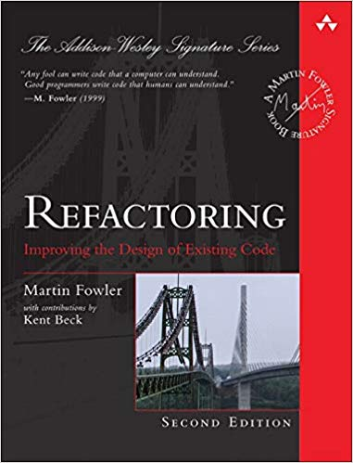
Reference Book on Refactoring

Slide 77
Refactor smelly code - Using TDD concepts
asdf

Slide 78
Refactoring Tips
Don’t refactor and change behavior simultaneously
Always run tests
If tests aren’t available, take only safe proven steps
Never skip the third leg of the TDD cycle
Avoid having to ask permission
Refactoring is part of your development process

Slide 79
LET’S REVIEW

Slide 80
DAY 1 - WRAP UP

Slide 81
DAY 2

Slide 82
DAY 1 - RECAP

Slide 83
SUT – System Under Test
The thing we’re currently writing Unit Tests for
Can have 1 or more dependencies (Fowler calls them “collaborators”)

Slide 84
Dependencies, Decoupled...
You want to isolate the SUT as much as possible!
Building an entire app object graph just for Unit Testing is not practical
Databases should never be a part of a Unit Test!
Loose Coupling Saves Lives!

Slide 85
Mocks and Fakes and Stubs, Oh My!
All the same thing: objects that simulate the behavior of real objects
This is how we decouple the “collaborators” from the SUT
Allows us to go beyond simply verifying just the state of the SUT
Opens the door to let us verify the behavior of the SUT

Slide 86
Mocks vs Stubs vs Fakes – Wha'choo talkin' 'bout, Willis?
Welcome to a controversial topic!
Stubs can be thought of having minimalistic behavior – just enough to allow the object under test to execute the test
A Mock is like a “smart” Stub in that the test will also verify that the object under test calls the mock as expected
A Fake has business behavior. You can drive a fake to behave in different ways by giving it different data

Slide 87
Mocks – How to use them
Most languages have a mocking framework available to use
Mocks and Stubs are easily created with a mocking framework
A Fake is usually easier to code by hand, but can still be done with a mocking framework

Slide 88
Mock Example Walkthrough – SUT
require subscription_service.rb
class User
def apply_subscription
SubscriptionService.new(self).apply
end
end

Slide 89
class UserTest < MiniTest::Test
test '#apply_subscription' do
mock = Minitest::Mock.new
mock.expect :apply, true
SubscriptionService.stub :new, mock do
user = users(:one)
assert user.apply_subscription
end
assert_mock mock # New in Minitest 5.9.0
assert mock.verify # Old way of verifying mocks
end
end

Slide 90
Mock Example – Third test walkthrough
asdf

Slide 91
Guided kata - execute first kata with scenarios
adf

Slide 92
Guided kata - execute first kata with scenarios
asdf

Slide 93
Designing for testability - examples
asdf

Slide 94
SIMPLE EVOLUTIONARY DESIGN

Slide 95
Design
Design principles and patterns
- vs -
Simple design
BDUF (Big Design Up Front)
- vs -
Emergent design

Slide 96
Simple Design
Runs all tests
No duplication
Expresses intent
Minimal number of classes & methods

Slide 97
Simple Design
Implies use of TDD
TDD promotes “tell don’t ask”
TDD pushes you to think about “how do I test this class in isolation?”
Minimizes coupling: the core of good OO design
Implies the system works as designed
Automated tests prove it

Slide 98
Simple Design: No Duplication
Duplication is your primary enemy
Increased cost: multiple places to make changes
Increased cost: overall comprehension of system
Increased risk: forgot to change on of these places
Drives toward many design patterns / principles
Single Responsibility Principle, Template Method, Open-Closed Principle

Slide 99
Simple Design: Expresses Intent
Directly relates to maintenance costs
Core idea behind design patterns
Communicating ideas using common terms / solutions
Promotes single responsibility principle

Slide 100
Simple Design: Minimal Number of Classes & Methods
Prevents over design
You don’t build things into the system that aren’t needed
Stopgap measure
Sometimes methods and classes don’t pull their own weight

Slide 101
It is Agile Software Design!
“Just enough” up-front design
Constant test-first unit testing
Constant attention to design impacts
Ruthless refactoring
It’s only code!
Malleable
Keep as clean as possible to ease addition of new features

Slide 102
Documentation Artifacts
Cost money!
Introduce into plan and estimate
Make executable where possible
Unit tests can supplant code specs, heredocs, design docs
Acceptance tests can supplant use cases, requirements docs

Slide 103
OTHER CONSIDERATIONS

Slide 104
How Big is a Test Method?
Multiple asserts might be a code smell
Could be too much in one test
Test functionality, not methods
Could suggest deficient design
Look to decouple behavior of classes under test
Underlying code may be linked
Look to combine into common assert method
One assert / test is a goal, not a rule

Slide 105
How Big is a Test Class?
Generally one test class per production class
But you can create more than one if necessary...
Organize around common setup
Need for these multiple test “fixtures” might suggest the need for a redesign

Slide 106
The 10 Minute Rule
TDD promotes consistent pacing
Expect a green bar at least every 10 minutes
Otherwise you kill the pace
Resist firing up the debugger on your code
A good tactic:
Discard all new code since the last green bar
Start over, taking even smaller steps

Slide 107
10 Minute Rule Implications
Tests must run fast
Rapid feedback is critical to TDD
Many TDD systems run thousands of tests in under 3 minutes

Slide 108
If Your Tests Run Sloooooww
Look at pervasive bad dependencies
Usually Database, File or other external IO
Improve design
Corral Data Access code
Introduce mocking where needed
Concession: run subsets of tests
Run at the largest possible scope
Isolate certain kinds of tests
Increases Risk

Slide 109
Testing Private Behavior
Often suggests need for redesign
Private methods become public tested methods on another class
If absolutely necessary, relax access specifier

Slide 110
Testing Private Data
Verifying behavior requires inspecting state
Sometimes you wouldn’t normally expose this state
Relax access specifier
No worries - we have tests!

Slide 111
LEGACY CODE & TDD

Slide 112
It’s a Catch-22
Existing systems do not have tests
We need tests in order to change code
In order to write tests, we often need to change code

Slide 113
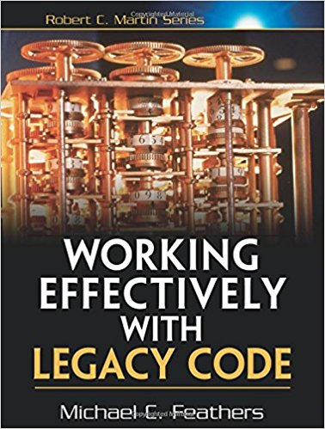
What is Legacy Code?
Michael Feathers defines it as: code without tests

Slide 114
Introducing Unit Tests to Legacy Code
Identify change points
Requires good understanding of system design
Find test points
Based on analysis of effects
Break dependencies using safe refactoring techniques
Write tests
Make changes and refactor

Slide 115
Effects Analysis
Identify method that will change
If it has a return value, examine its callers
Determine if it modifies any values
If so, examine methods that use those values
Also examine methods that use those methods
Make sure you examine super/subclasses
Examine parameters to the methods
Examine global variables and static data modified in any of the identified methods

Slide 116
Breaking Dependencies
Two reasons to break dependencies when putting tests into place
To sense - when we can’t access computation results
To separate - when we can’t get code to run in a test harness
Primary technique - fake collaborators
Impersonate a collaborator of the class under test

Slide 117
Seams
Code place allowing you to alter behavior
Without editing that place
Most Java seams based on polymorphism
Known as object seams
public int value() {
if (null == holding)
return 0;
int price = stockLookupService.price(holding.getSymbol());
return price * holding.getShares();
}
The call to price() is a seam
Can replace the reference stockLookupService

Slide 118
Refactoring Safely
Any manual edits are error prone!
Rely on your IDE refactoring where possible
May need to manual refactor before you are able to write tests
Don’t do more than one thing at a time
Be hyper-aware of the impact of each keystroke
Single-goal editing

Slide 119
Legacy Code Example - Get Code Under Test
asdf

Slide 120
Some Dependency Breaking Techniques
Break Out Method Object
Move a large method to new class
Local variables in original method become fields
Extract Interface
Create an Interface for some subset of methods
Create fake based upon this interface
Introduce Instance Delegator
Solves problem of “static cling”
Opposite of Expose Static Method

Slide 121
Legacy Code Example - Refactor
asdf

Slide 122
WRAP-UP!

Slide 123
Going Forward
Team determines policy going forward
“All new code written using tests”
“Code without tests must be inspected”
Concentrate on legacy code that is causing problems or is the most difficult to modify
Consider pairing
Helps ingrain techniques
Ensures adherence

Slide 124
Final Thoughts
TDD is here to stay
A satisfying and enriching practice that can dramatically increase the quality of your application
Diligent adherence to practice is required to succeed
But the benefits are worth it

Slide 125
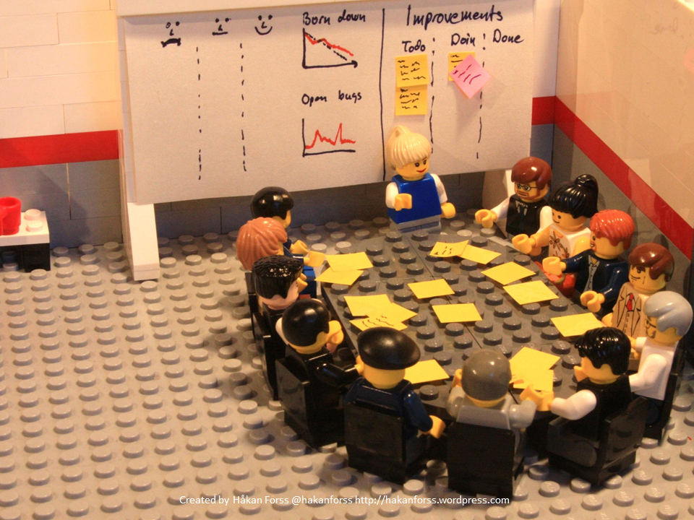
RETROSPECTIVE

Slide 126


